Slide 1
VLSI Test Principles and Architectures
Chapter 6, Test Compression
Haochen Ding

Slide 2
INTRODUCTION
00

Slide 3
00 Introduction
Test Compression
Definition: to compress the amount of test data (both stimulus and response) that is stored on the tester.
It reduces the amount of tester memory that is required.
It reduces test time.
Category:
using data compression codes
employing linear decompression
broadcasting the same value to multiple scan chains
Lossy compression = compaction (some fault coverage may be lost)

Slide 4
00 Introduction
Test Compression & BIST
Traditional standalone BIST does all the test pattern generation and output response analysis on-chip, without requiring any tester storage.
Hybrid BIST can reduce the amount of test data on the tester more than test compression, but it generally requires longer overall test time.
The advantage of test compression is that the exact set of patterns that are applied to the CUT is selected through ATPG and thus can be minimized with respect to the desired fault coverage.

Slide 5
00 Introduction – Contents of This Chapter
01 Test Stimulus Compression
02 Test Response Compaction

Slide 6
Test Stimulus Compression
01

Slide 7
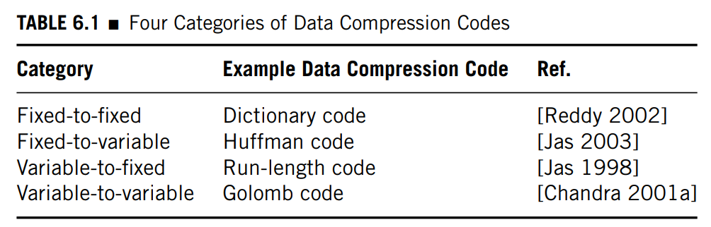
01 Test Stimulus Compression – Code-Based Schemes
Test Stimulus Compression: Code-Based Schemes
Data compression codes partition the original data into symbols, and then each symbol is replaced with a codeword to form the compressed data.
Data compression codes can be classified into four categories, depending on whether the symbols have a fixed size (i.e., each symbol contains exactly n bits) or a variable size (i.e., different symbols have different numbers of bits) and whether the codewords have a fixed or variable size.

Slide 8
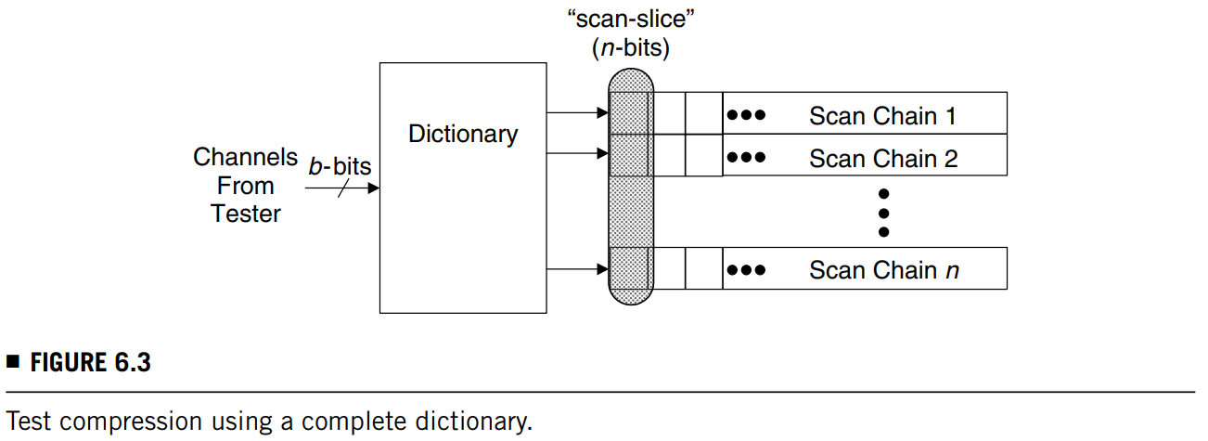

01 Test Stimulus Compression – Code-Based Schemes
Test Stimulus Compression: Code-Based Schemes
Fixed-to-Fixed: Dictionary Code
Compressing an n-length symbol into a b-length codeword, given that $2^{b}>\left|S_{data}\right|>2^{b−1}.$
Compression ratio: $2^{n}−\left|S_{data}\right|:1$
The size of the dictionary can still be very large.

Slide 9
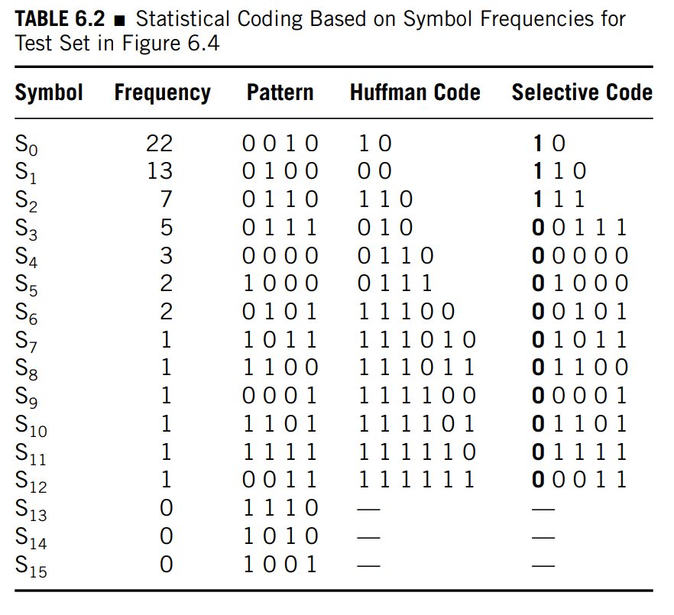
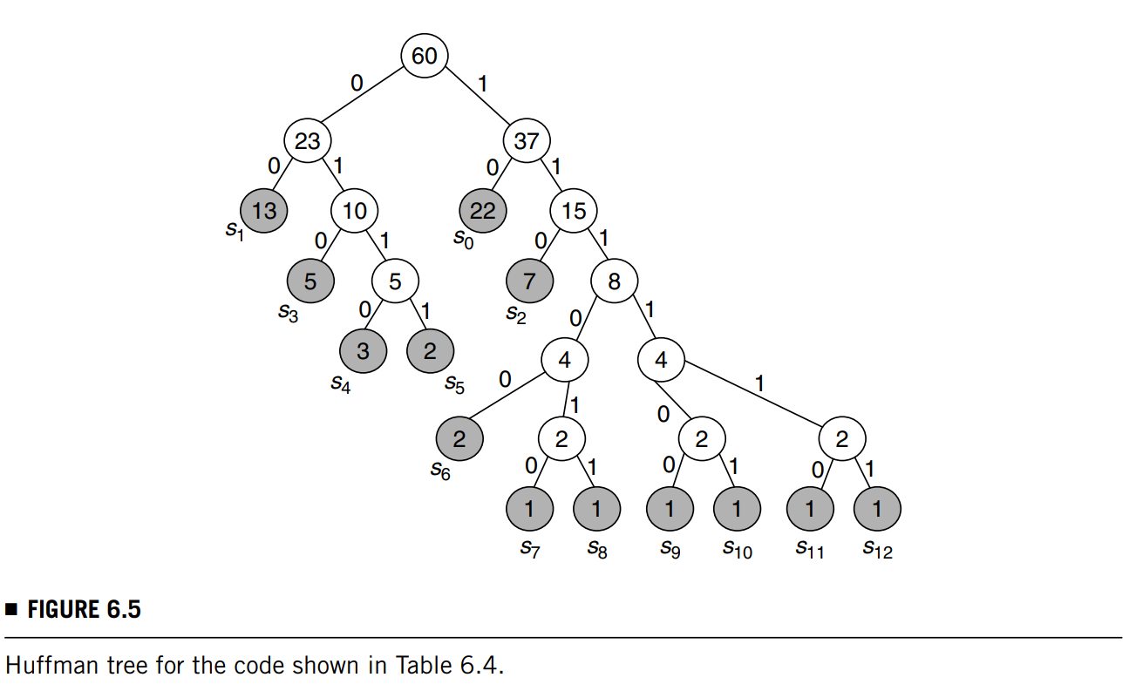
01 Test Stimulus Compression – Code-Based Schemes
Test Stimulus Compression: Code-Based Schemes
Fixed-to-Variable: Huffman Code
Calculate the frequency of occurrence of the different symbols in the original test cubes and make the codewords that occur most frequently have fewer bits and those that occur least frequently more bits.
Selective: the tree is only built for a selective number of symbols.

Slide 10
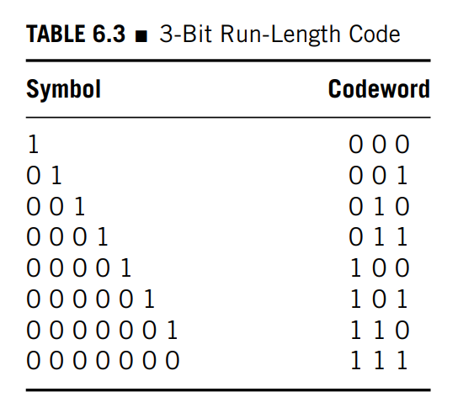
01 Test Stimulus Compression – Code-Based Schemes
Test Stimulus Compression: Code-Based Schemes
Variable-to-Fixed: Run-Length Code
Only the number (rather than the length) of symbols matter.

Slide 11
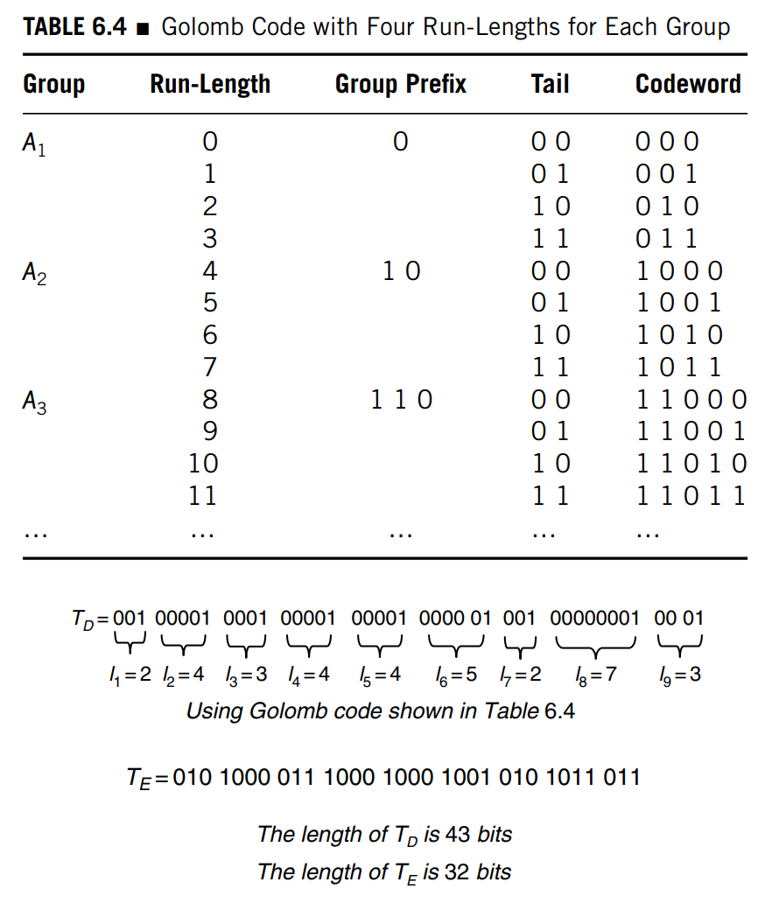
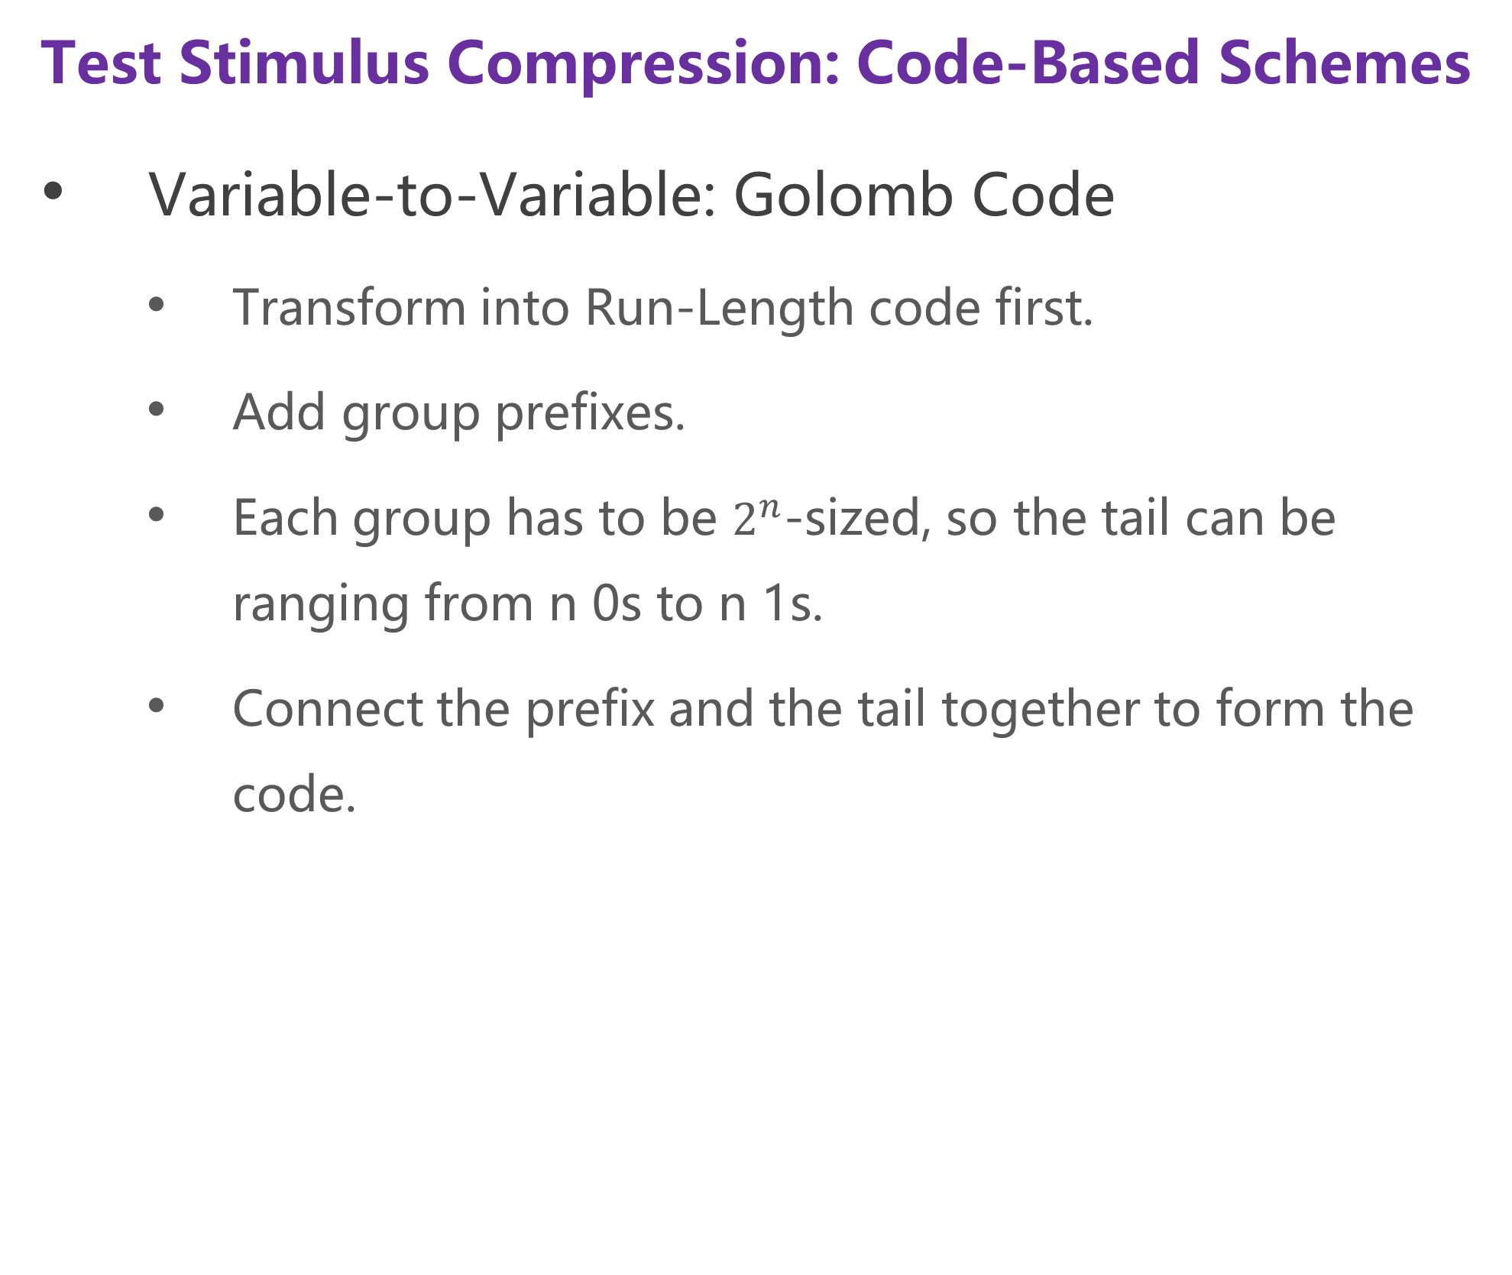
01 Test Stimulus Compression – Code-Based Schemes
Test Stimulus Compression: Code-Based Schemes
Variable-to-Variable: Golomb Code
Transform into Run-Length code first.
Add group prefixes.
Each group has to be $2^{n}$-sized, so the tail can be ranging from n 0s to n 1s.
Connect the prefix and the tail together to form the code.

Slide 12
01 Test Stimulus Compression – Linear-Decompression-Based Schemes
Test Stimulus Compression: Linear-Decompression Schemes
Any decompressor that consists of only XOR gates and flip-flops is a linear decompressor.
Their output space (i.e., the space of all possible test vectors that they can generate) is a linear subspace that is spanned by a boolean matrix.
For boolean matrices, XOR is used in place of addition and AND in place of multiplication.

Slide 13
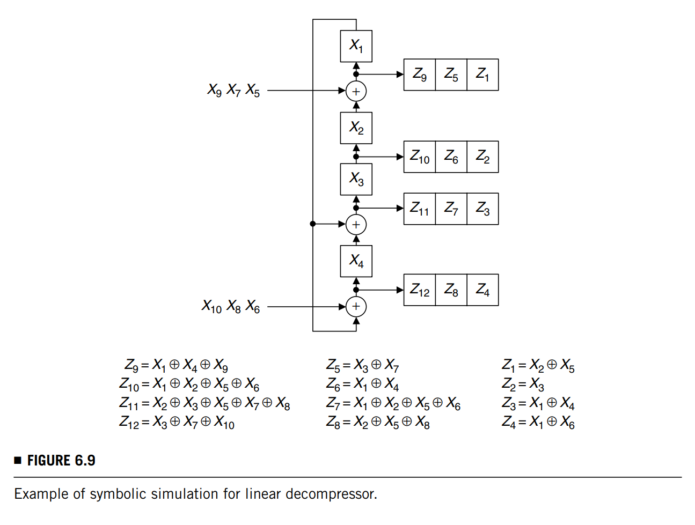
01 Test Stimulus Compression – Linear-Decompression-Based Schemes
Test Stimulus Compression: Linear-Decompression-Based Schemes
1st Cycle:
Z1 = X2 ⊕ X5
Z2 = X3
Z3 = X1 ⊕ X4
Z4 = X1 ⊕ X6
Next Cycle:
Z1(next) = Z2 ⊕ Left-top input
Z2(next) = Z3
Z3(next) = Z4 ⊕ Z1
Z4(next) = Z1 ⊕ Left-bottom input

Slide 14
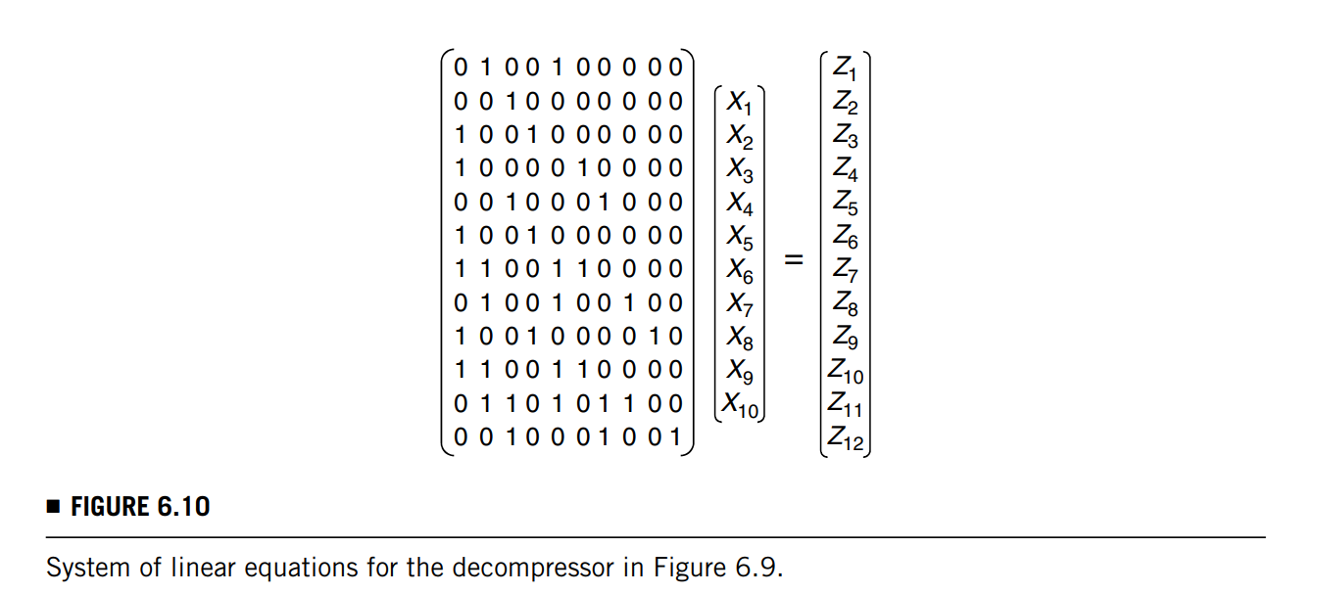
01 Test Stimulus Compression – Linear-Decompression-Based Schemes
Test Stimulus Compression: Linear-Decompression-Based Schemes
If the linear equations have no possible solution, it is not possible to encode that test cube with this particular linear decompressor.
(Bypass the decompressor, rerun the ATPG or redesign the decompressor)

Slide 15
01 Test Stimulus Compression – Linear-Decompression-Based Schemes
Test Stimulus Compression: Linear-Decompression-Based Schemes
Combinational Linear Decompressors:
Advantages: simpler hardwares & control
Drawbacks:
Each scan slice must be encoded using only the free variables that are shifted from the tester in a single clock cycle.
The worst-case most highly specified scan slices tend to limit the amount of compression that can be achieved.

Slide 16
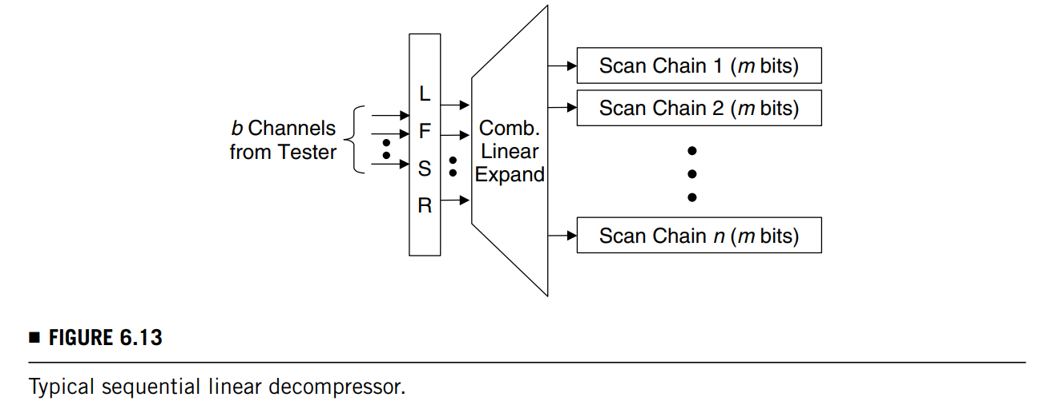
01 Test Stimulus Compression – Linear-Decompression-Based Schemes
Test Stimulus Compression: Linear-Decompression-Based Schemes
Sequential Linear Decompressors:
Advantages
It allows free variables from earlier clock cycles to be used when encoding a scan slice in the current clock cycle
Drawbacks:
The encoding efficiency is limited by the worst-case most heavily specified test cube.

Slide 17
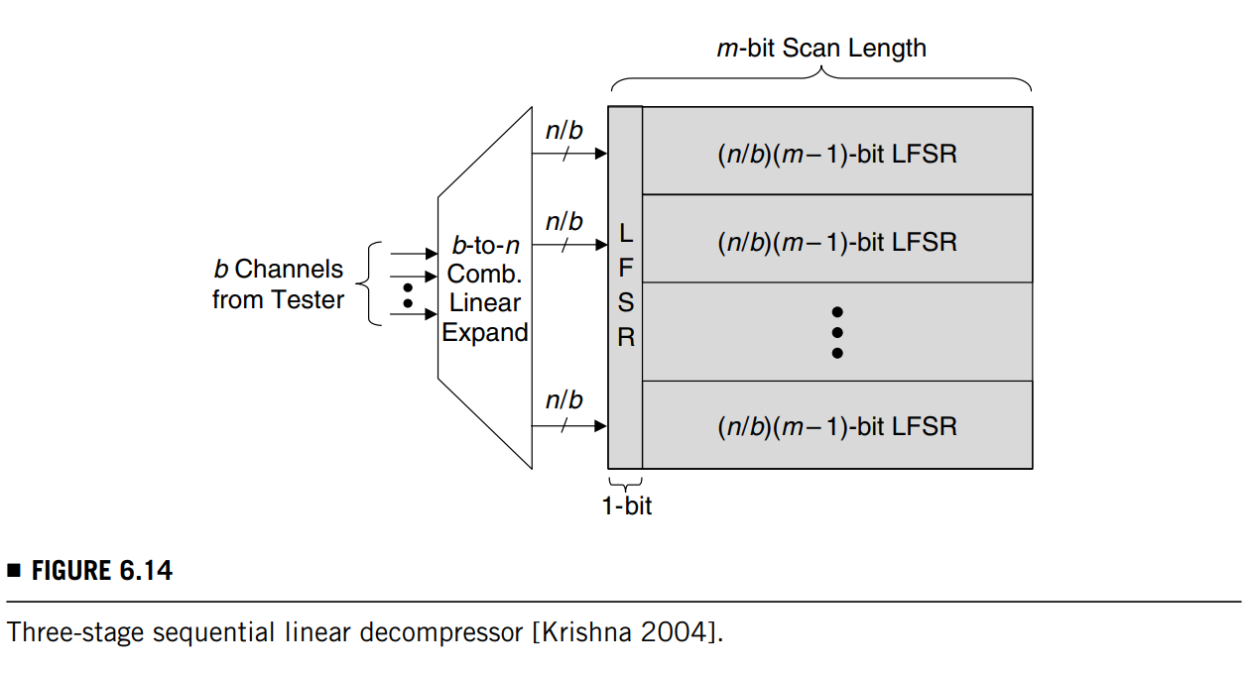
01 Test Stimulus Compression – Linear-Decompression-Based Schemes
Test Stimulus Compression: Linear-Decompression-Based Schemes
Variable-Length Sequential Linear Decompressors:
Advantages
Better encoding efficiency can be achieved by using only as many free variables as are needed to encode each test cube.
Drawbacks:
It needs additional gating channels, which diminishes the amount of test compression achieved in proportion with the total number of channels being used.
Encoding efficiencies greater than 0.99 can be obtained with this architecture without requiring any constraints on the ATPG. The drawback is the need to add logic in the scan chains to configure them as LFSRs.

Slide 18
01 Test Stimulus Compression – Broadcast-Scan-Based Schemes
Test Stimulus Compression: Broadcast-Scan-Based Schemes
Due to its simplicity and effectiveness, this method has been used as the basis of many test compression architectures, including some commercial design for testability (DFT) tools.

Slide 19
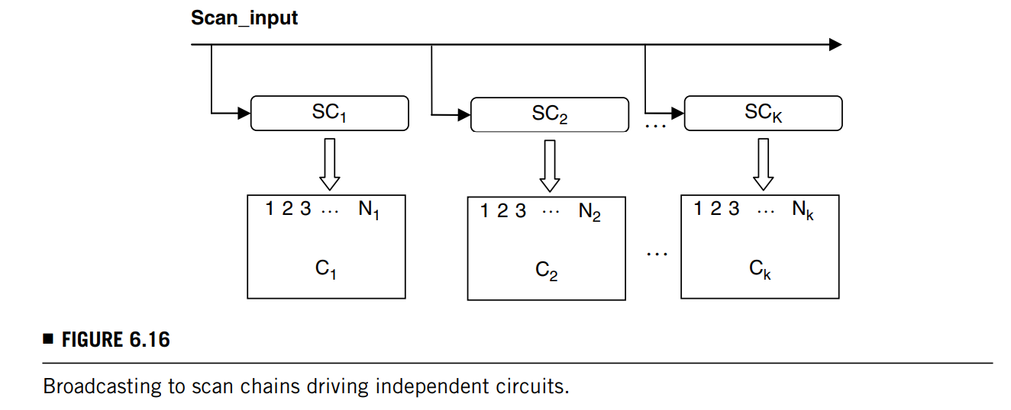
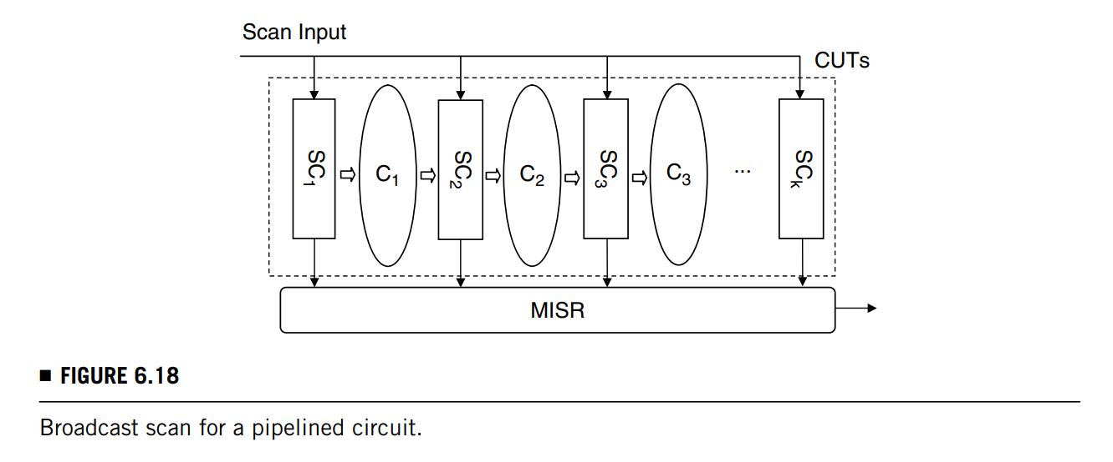
01 Test Stimulus Compression – Broadcast-Scan-Based Schemes
Test Stimulus Compression: Broadcast-Scan-Based Schemes
Broadcast Scan
In the beginning of the ATPG process, usually random patterns are used to detect the easy-to-detect faults.
After most faults have been detected by the random patterns, deterministic patterns are generated for the remaining difficult-to-detect faults. (many “don’t care” bits may still exist)
All faults that are detectable in all original circuits will also be detectable with the broadcast structure.

Slide 20
01 Test Stimulus Compression – Broadcast-Scan-Based Schemes
Test Stimulus Compression: Broadcast-Scan-Based Schemes
Illinois Scan
If broadcast scan is used for multiple scan chains of a single circuit where the subcircuits driven by the scan chains are not independent, then the property of always being able to detect all faults is lost.
The reason for this is that if two scan chains are sharing the same channel, then the i-th scan cell in each of the two scan chains will always be loaded with identical values. If some fault requires two such scan cells to have opposite values in order to be detected, it will not be possible to detect this fault with broadcast scan.

Slide 21
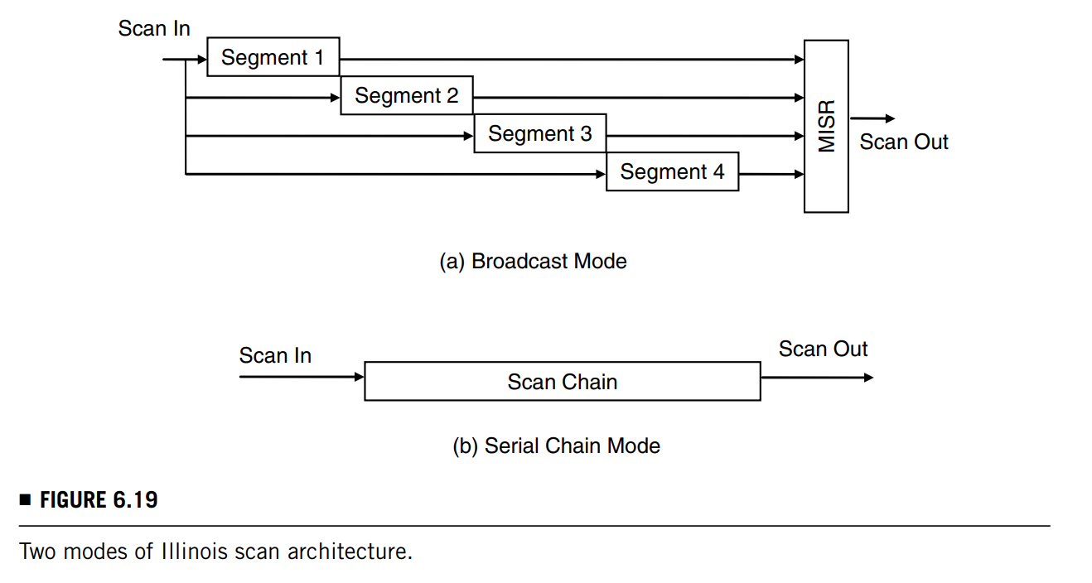
01 Test Stimulus Compression – Broadcast-Scan-Based Schemes
Test Stimulus Compression: Broadcast-Scan-Based Schemes
Illinois Scan
Broadcast Mode
A scan chain is divided into multiple subchains (segments) and the same vector can be shifted into all segments through a single shared scan-in input.
Serial Chain Mode
For the remaining faults that cannot be detected in broadcast mode, the serial scan mode is used where any possible test pattern can be applied.
No test compression is achieved when it is run in serial scan mode.

Slide 22
01 Test Stimulus Compression – Broadcast-Scan-Based Schemes
Test Stimulus Compression: Broadcast-Scan-Based Schemes
Multiple-Input Broadcast Scan
If two scan chains must be independently controlled to detect a fault, then they could be assigned to different channels.
The more channels that are used and the shorter each scan chain is, the easier it is to detect more faults because fewer constraints are placed on the ATPG.

Slide 23
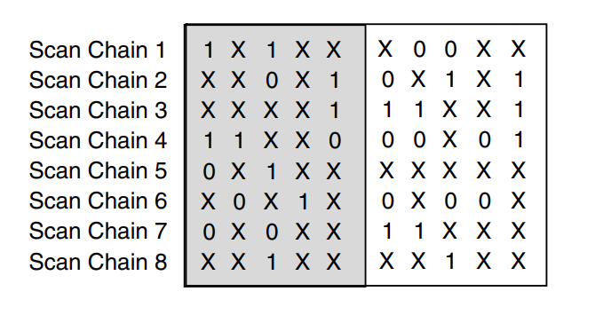
01 Test Stimulus Compression – Broadcast-Scan-Based Schemes
Test Stimulus Compression: Broadcast-Scan-Based Schemes
Reconfigurable Broadcast Scan
In static reconfiguration, the reconfiguration can only be done when a new pattern is to be applied.
For this method, the target fault set can be divided into several subsets, and each subset can be tested by a single configuration.
After testing one subset of faults, the configuration can be changed to test another subset of faults.
In dynamic reconfiguration, the configuration can be changed while scanning in a pattern.
This provides more reconfiguration flexibility and hence can in general lead to better results with fewer channels.
Example: in every channel, no scan chain can be both 0 and 1 (0 and X, 1 and X, single 0, single 1 are all OK)
1 → 2 3 6 7；2 → 5 8；3 → 1 4
1 → 1 6；2 → 2 4；3 → 3 5 7 8

Slide 24
01 Test Stimulus Compression – Broadcast-Scan-Based Schemes
Test Stimulus Compression: Broadcast-Scan-Based Schemes
Virtual Scan
Definition: Using combinational logic network, which can consist of any combination of simple combinational gates, such as buffers, inverters, AND/OR gates, MUXs, and XOR gates, as decompressors.
Advantage: it allows the ATPG to directly search for a test cube that can be applied by the decompressor and allows very effective dynamic compaction.
Drawback: it may take longer than those based on solving linear equations to generate test cubes or compressed stimuli.

Slide 25
Test Response Compaction
02

Slide 26
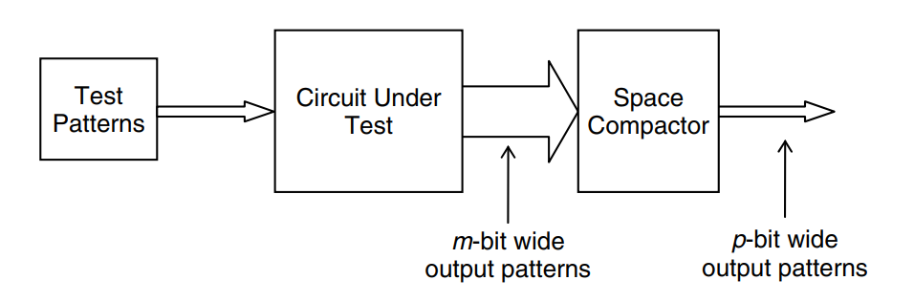
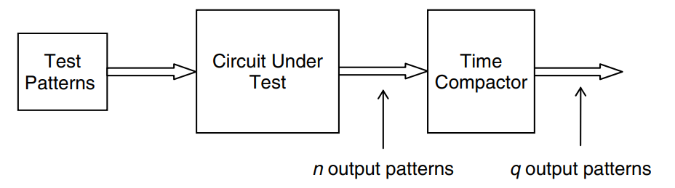
02 Test Response Compaction
Test Response Compaction
Can be lossy!
Time & Space
If a m × n bits matrix D is transformed into a p × q matrix C (C = φ(D)), then define m/p as space compaction ratio, n/q as time compaction ratio. (p<m, q<n)
The column index of test data matrix D is referred to as the time dimension because it corresponds to the output bits from a single circuit output resulting from the application of different input test patterns.
The row index of the test data matrix D is referred to as the space dimension because it corresponds to the output bits from different circuit outputs resulting from the application of the input test pattern.

Slide 27
02 Test Response Compaction
Test Response Compaction
CFI(Circuit-function-independent) & CFS (Circuit-function-specific)
The compaction function φ is CFI if it is selected regardless of the test data expected to originate from either the fault-free or faulty circuit.
Linear & Nonlinear
A response compactor is said to be linear if it consists of only XOR gates and flip-flops.
For linear compactors, the compacting function φ is such that each bit of the compacted data matrix C can be expressed as a boolean sum (XOR sum) of any number of bits of the data matrix D. Thus, for linear compactors, φ is a linear operator.

Slide 28
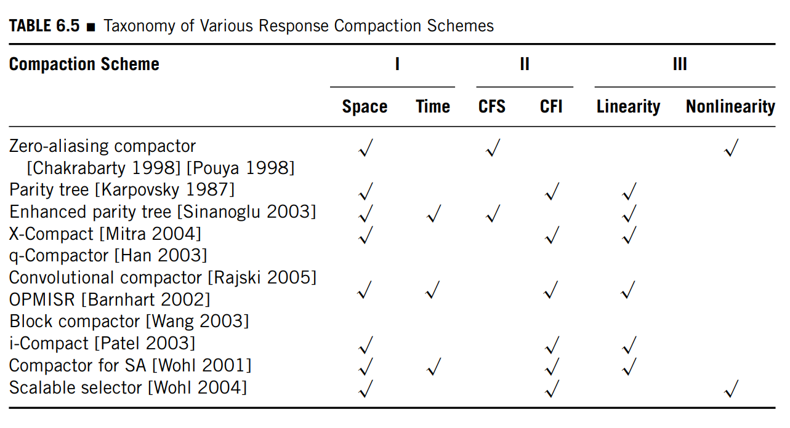
02 Test Response Compaction
Test Response Compaction

Slide 29
02 Test Response Compaction
Test Response Compaction
For complex designs, logic simulators cannot always deterministically predict the logic values of all test response bits.
Because of the loss, response compaction techniques face two major challenges:
Aliasing: different uncompressed data A and uncompressed data B yield the same compressed data C after compaction.
Fault diagnosis: a better diagnosis is to locate the failing scan cells in the scan chains from the outputs of the compactor without configuring the chip in a special diagnosis mode.

Slide 30
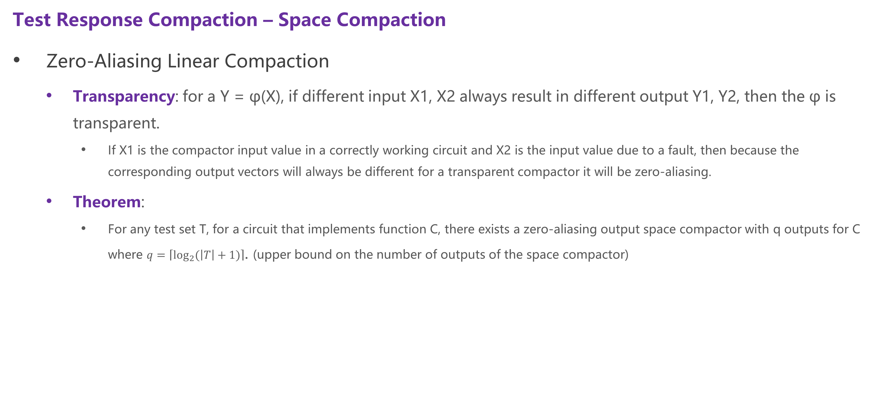
02 Test Response Compaction – Space Compaction
Test Response Compaction – Space Compaction
Zero-Aliasing Linear Compaction
Transparency: for a Y = φ(X), if different input X1, X2 always result in different output Y1, Y2, then the φ is transparent.
If X1 is the compactor input value in a correctly working circuit and X2 is the input value due to a fault, then because the corresponding output vectors will always be different for a transparent compactor it will be zero-aliasing.
Theorem:
For any test set T, for a circuit that implements function C, there exists a zero-aliasing output space compactor with q outputs for C where $q=\left\lceil \log_{2}{(\left|T\right|+1)}\right\rceil$. (upper bound on the number of outputs of the space compactor)

Slide 31
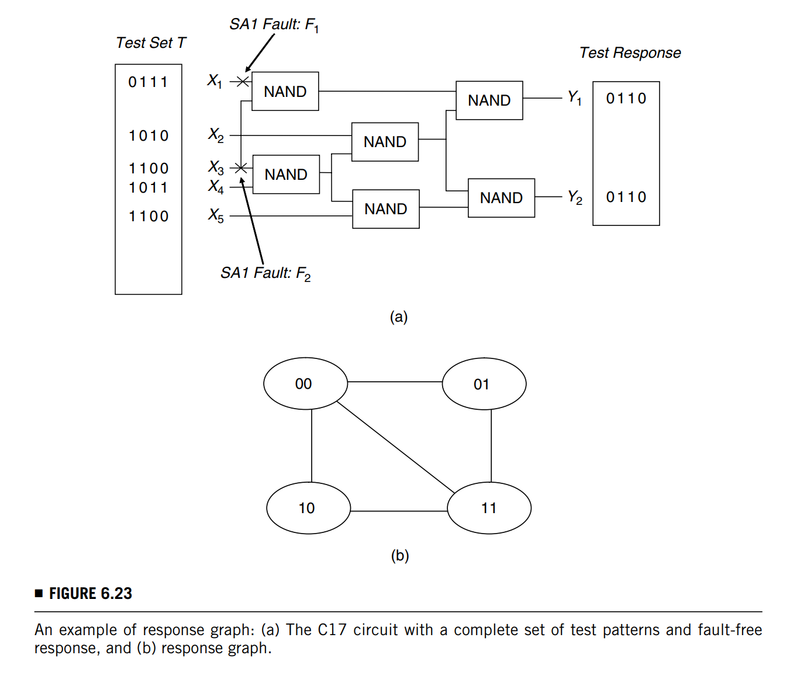
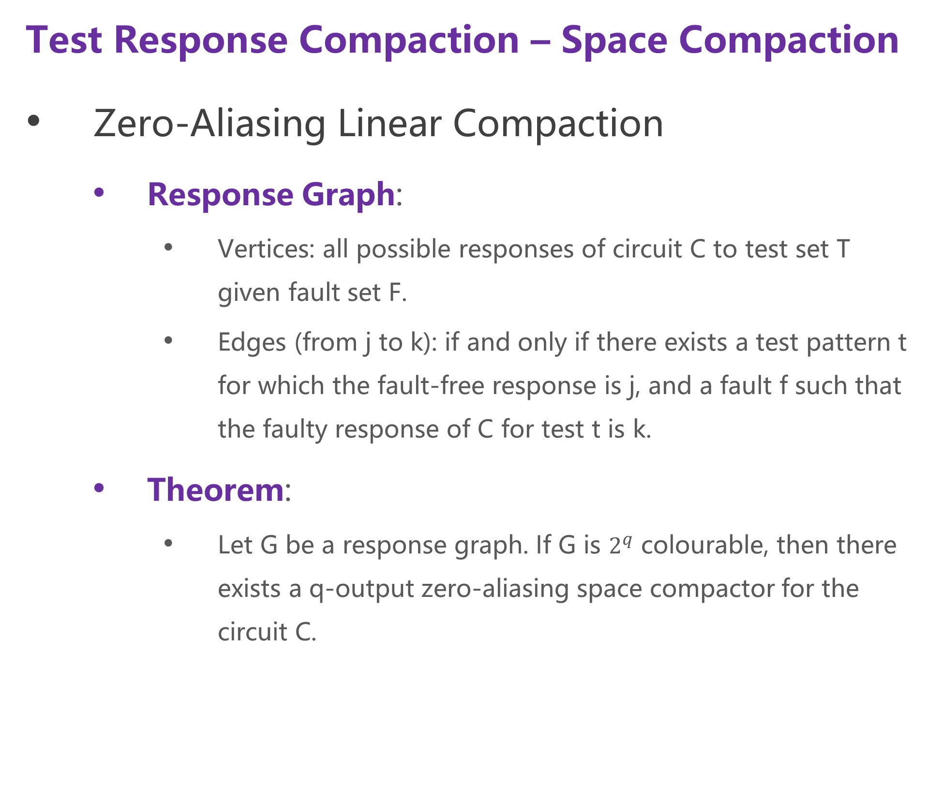
02 Test Response Compaction – Space Compaction
Test Response Compaction – Space Compaction
Zero-Aliasing Linear Compaction
Response Graph:
Vertices: all possible responses of circuit C to test set T given fault set F.
Edges (from j to k): if and only if there exists a test pattern t for which the fault-free response is j, and a fault f such that the faulty response of C for test t is k.
Theorem:
Let G be a response graph. If G is $2^{q}$ colourable, then there exists a q-output zero-aliasing space compactor for the circuit C.

Slide 32
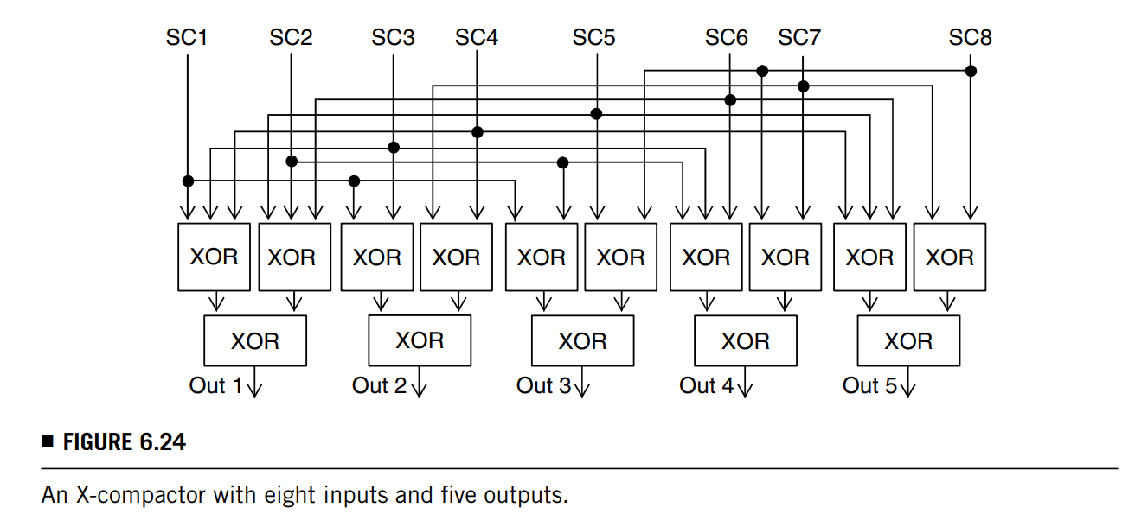
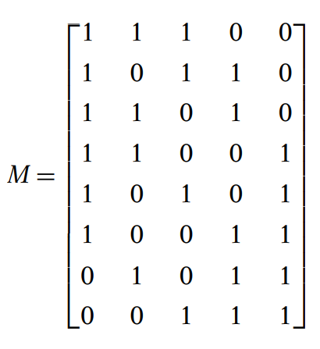
02 Test Response Compaction – Space Compaction
Test Response Compaction – Space Compaction
X-Compaction
The X-compactor can be represented as a binary matrix (matrix with only 0’s and 1’s) with n rows and k columns
Each row of the X-compact matrix corresponds to a scan chain and each column corresponds to an X-compactor output. The entry in row i and column j of the matrix is 1 if and only if the j-th X-compactor output depends on the i-th scan chain output; otherwise, the matrix entry is 0.

Slide 33
02 Test Response Compaction – Space Compaction
Test Response Compaction – Space Compaction
X-Compaction
Aliasing source
Error masking: one or more errors captured in the compactor during a single cycle propagate through the feedback path and cancel out with errors in the later cycles.
Error cancellation: an error bit captured in a shift register is shifted and eventually cancelled by another error bit.
Theorems:
If only a single scan chain produces an error at any scan-out cycle, the X-compactor is guaranteed to produce errors at the X-compactor outputs at that scan-out cycle, if and only if no row of the X-compact matrix contains all 0’s.
If every row of the X-compact matrix is nonzero, distinct, and contains an odd number of 1’s, then errors from any one, two, or an odd number of scan chains at the same scan-out cycle are guaranteed to produce errors at the X-compactor outputs at that scan-out cycle.
The X-compactor cannot guarantee that errors other than those described in theorems above are detectable.

Slide 34
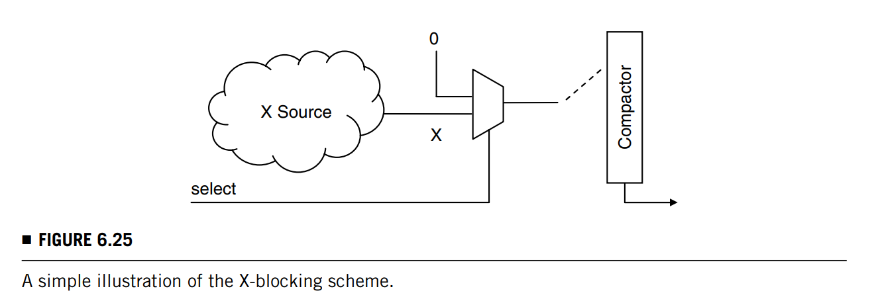
02 Test Response Compaction – Space Compaction
Test Response Compaction – Space Compaction
X-bounding / X-blocking
These X-blocking or X-bounding methods have been extensively discussed in Section 5.2 (BIST Design Rules) of Chapter 5.

Slide 35
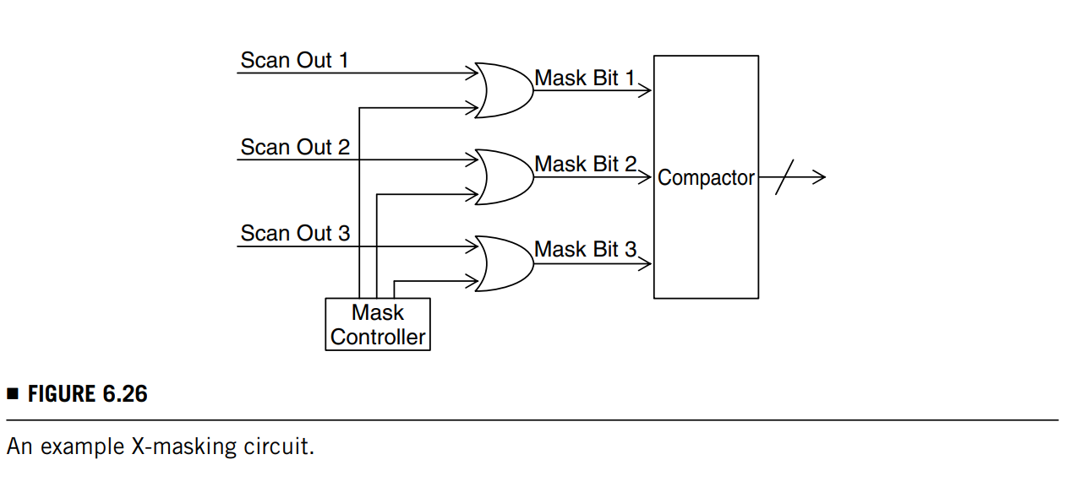
02 Test Response Compaction – Space Compaction
Test Response Compaction – Space Compaction
X-masking
The X-blocking technique does add area overhead and may impact delay due to the inserted logic.
Instead of blocking the X’s where they are generated, the X’s can also be masked off right before the response compactor.

Slide 36
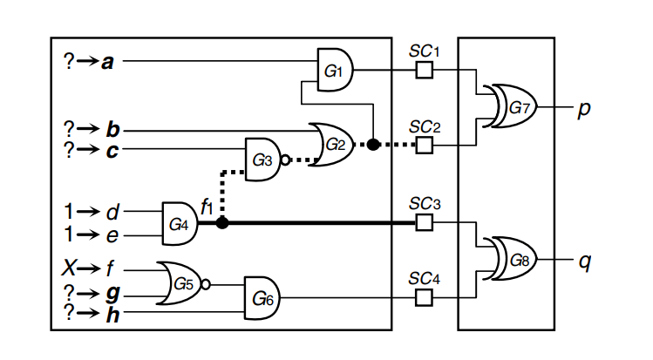
02 Test Response Compaction – Space Compaction
Test Response Compaction – Space Compaction
X-impact
Example 1: The f1 stuck-at 0 fault effect will be captured by scan cell SC3. If the X on f propagates to SC4, then the compactor output q will become X and f1 cannot be detected.
To avoid this, ATPG can try to assign either 1 to line g or 0 to line h in order to block the X from reaching SC4.
If it is impossible to achieve this assignment, ATPG can then try to assign 1 to line c, 0 to line b, and 0 to line a in order to propagate the fault effect to SC2. As a result, fault f1 can be detected.
Thus, X-impact is avoided by algorithmic assignment without adding any extra circuitry.

Slide 37
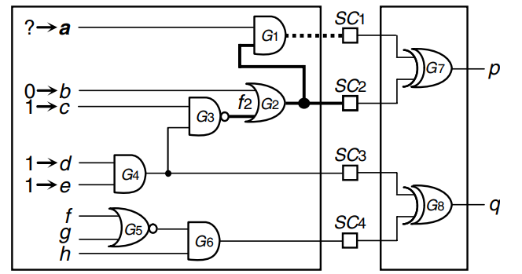
02 Test Response Compaction – Space Compaction
Test Response Compaction – Space Compaction
X-impact
Example 2: if line a is set to 1, the f2 stuck-at 1 fault effect will also propagate to SC1. In this case, aliasing will cause the compactor output p to have a fault-free value, resulting in an undetected f2.
To avoid this, ATPG can try to assign 0 to line a in order to block the fault effect from reaching SC1. As a result, fault f2 can be detected.
Thus, aliasing can be avoided by algorithmic assignment without any extra circuitry.

Slide 38
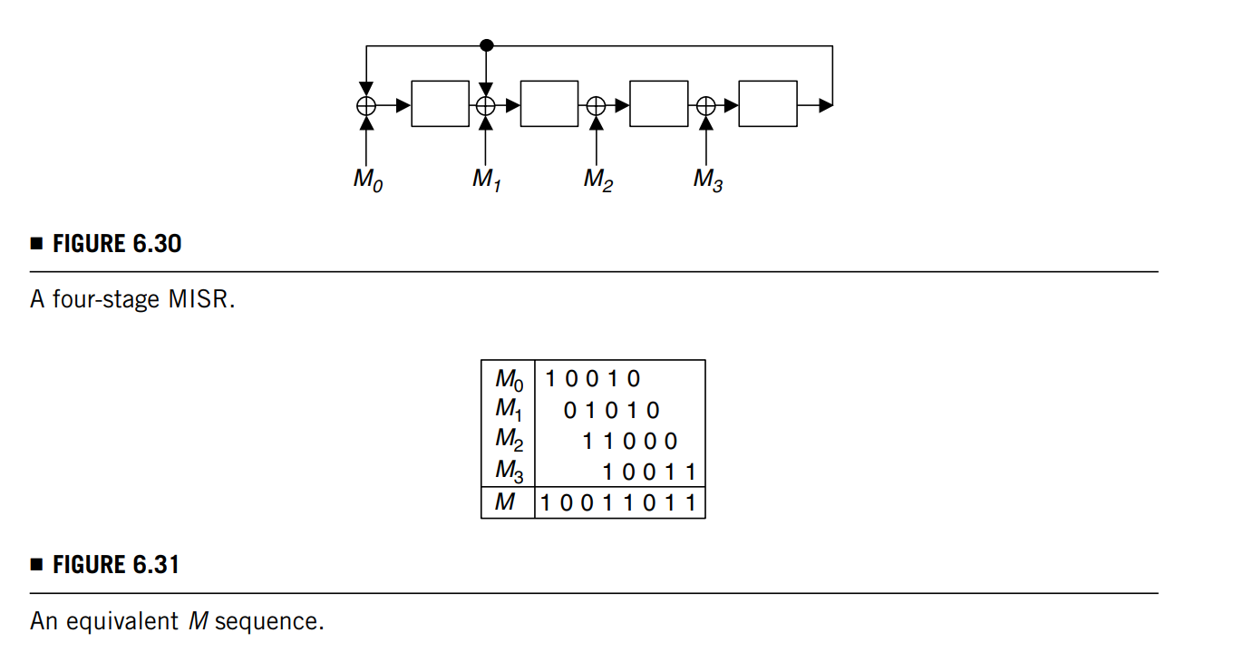
02 Test Response Compaction – Time Compaction
Test Response Compaction – Time Compaction
Multiple-input Signature Register (MISR)
Similar to SISR introduced in Chapter 5.
R=1011

Slide 39
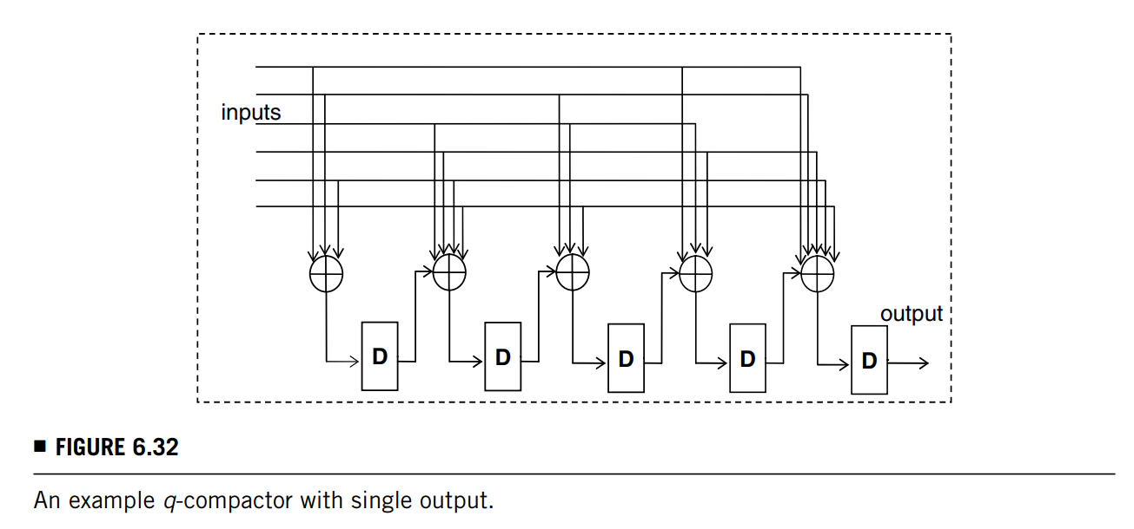
02 Test Response Compaction – Mixed Time and Space Compaction
Test Response Compaction – Mixed Time and Space Compaction
Q-compactor
The spatial part of the q-compactor consists of single-output XOR networks (called spread networks) connected to the flip-flops by means of additional two-input XOR gates interspersed between successive storage elements.
Different from a conventional MISR, the q-compactor does not have a feedback path; consequently, any error or X injected into the compactor is shifted out after at most five cycles.

Slide 40
Thanks for listening!
Haochen Ding

